Slide 1
Performance and Lighting tests
By Jenna Horn

Slide 2
Performance overView
We wanted to test how each of the libraries reacted to a large amount of cylinders in the renderer. I made a duplicating function that would generate a cylinder and then transform it so that it is clearly visible. Testing was done in Windows Explorer on local server.

Slide 3
FPS Results

Slide 4
Summary
Three.js
VTK.js
Max Render = 12,000+ Cylinders
Duplication was easy since only a new Mesh(Actor) had to be made and the geometry and material could be reused.
Max render = 800 Cylinders
Duplication was difficult because the actors cannot transform and I therefore had to make new Line Sources. This also required a new filter, mapper and actor for each new Cylinder.

Slide 5
Lights Overview (three.js)
Ambient Light: This light brightens up the entire scene. It does not create shadows
Point Light: A light rendered at a point where the intensity increases the closer the object is. Will render shadows
Directional Light: A light plane that renders in one direction for the entire render space. It is similar to sunlight.
Hemispherical Light: A hybrid between Ambient and Point Light that acts an outside light.
Spot Light: A light generated as a cone shape that creates a spotlight effect in the scene

Slide 6
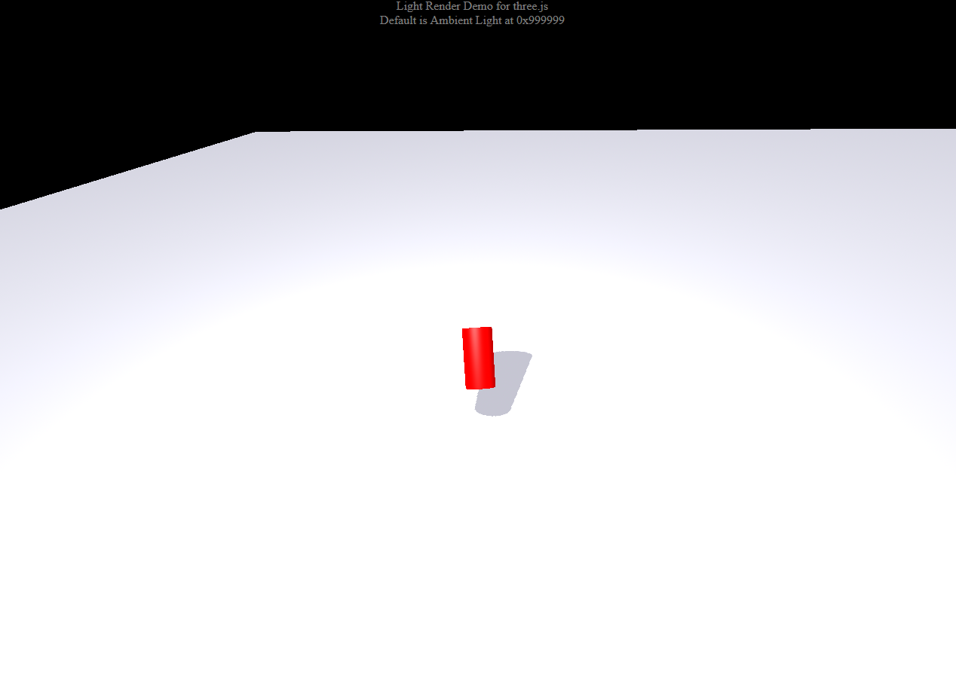
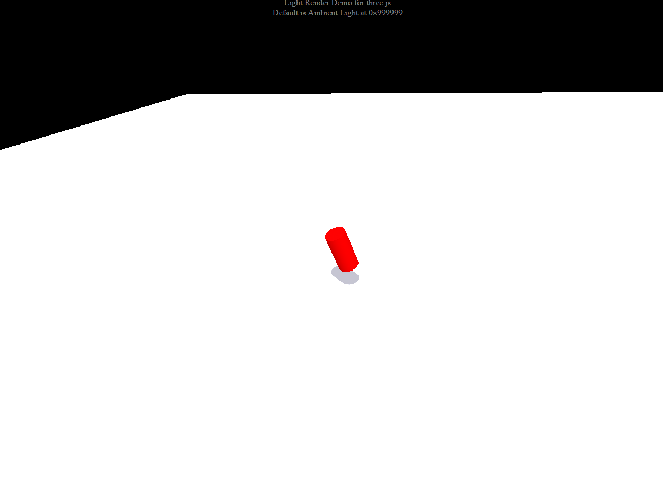
Lights (Three.js)
Point Light
Directional Light

Slide 7
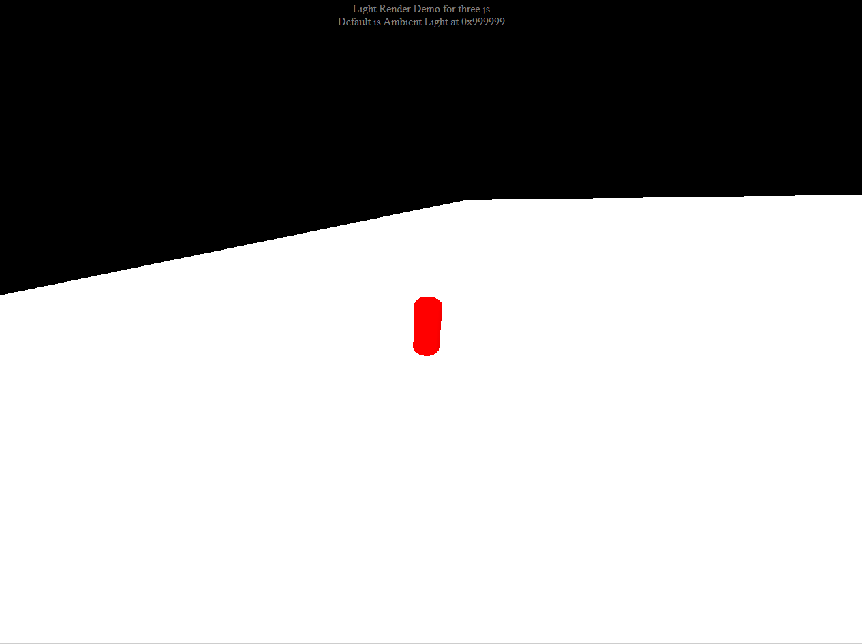
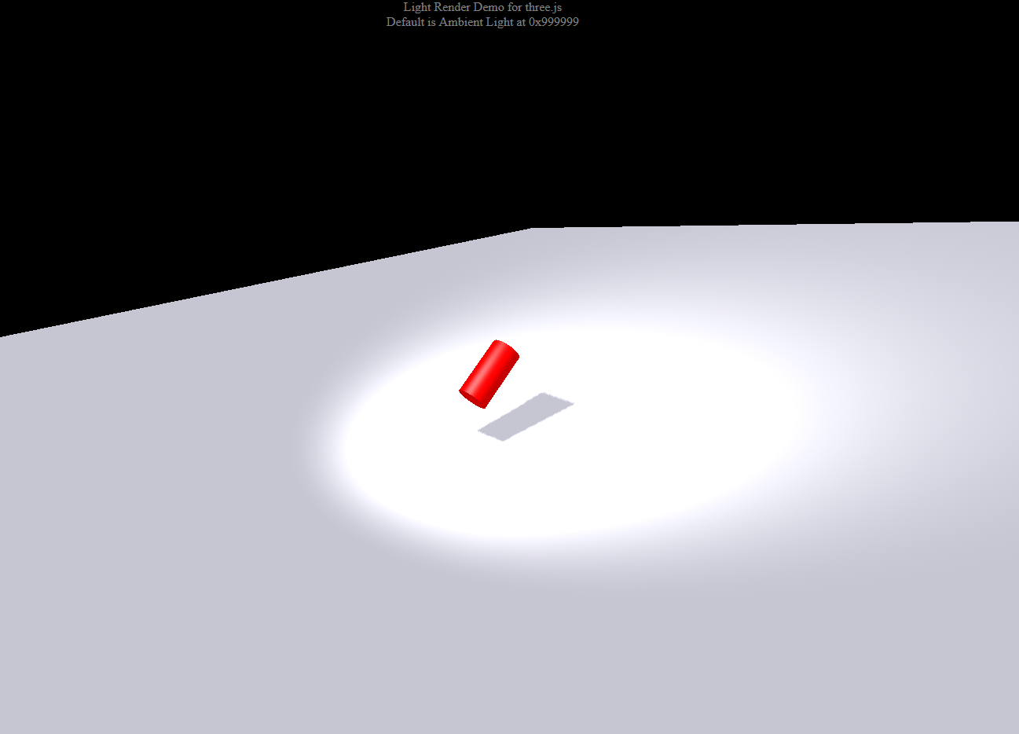
Lights (Three.js)
Hemisphere Light
Spot Light

Slide 8
Lights Overview (VTk.js)
Ambient Light/ Head Light: Default light renders as a plane that renders in one direction.
Scene Light: Acts as a sphere and renders in all directions from a set point.
Camera Light: Acts the same as the scene light except the light follows the position of the camera, therefore the objects are always lit.

Slide 9
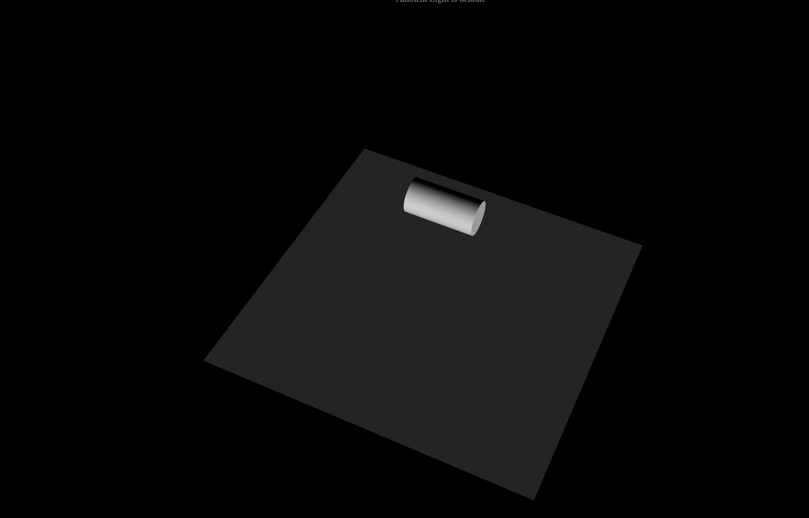
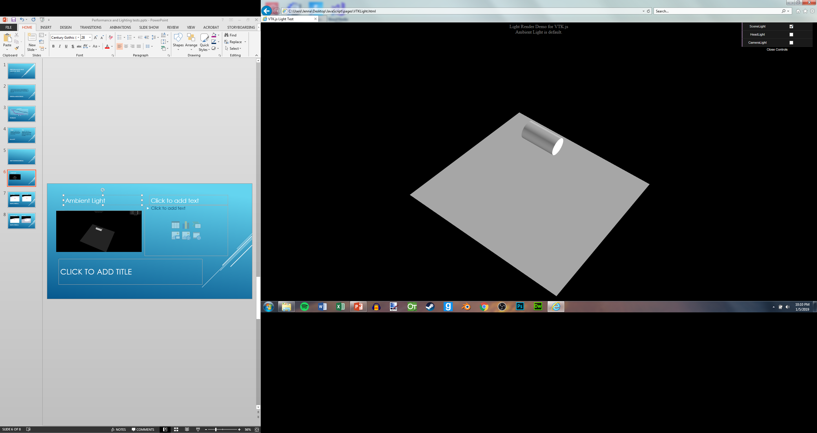
Lights (VTK.js)
Ambient Light
Scene Light

Slide 10
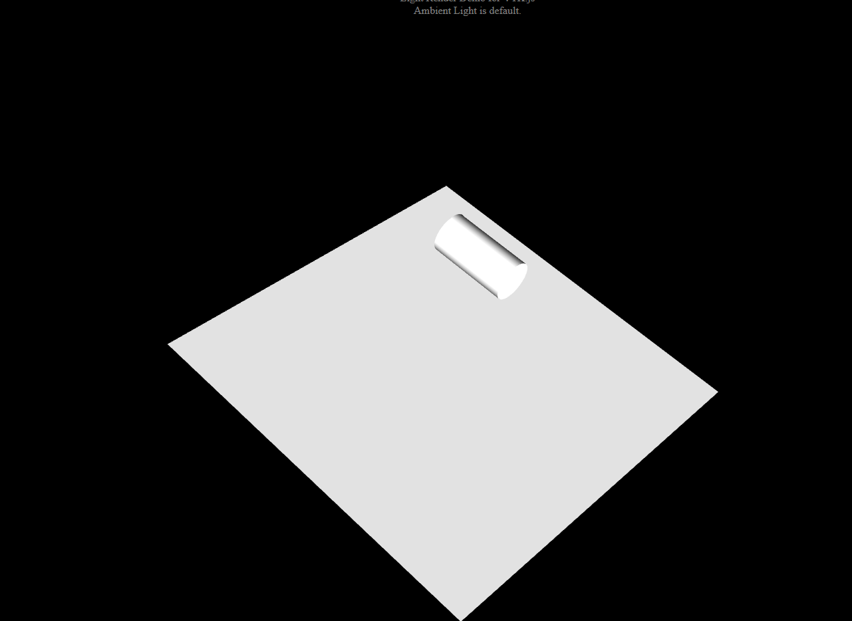
Lights (vtk.js)
Head Light
Camera Light

